Slide 1

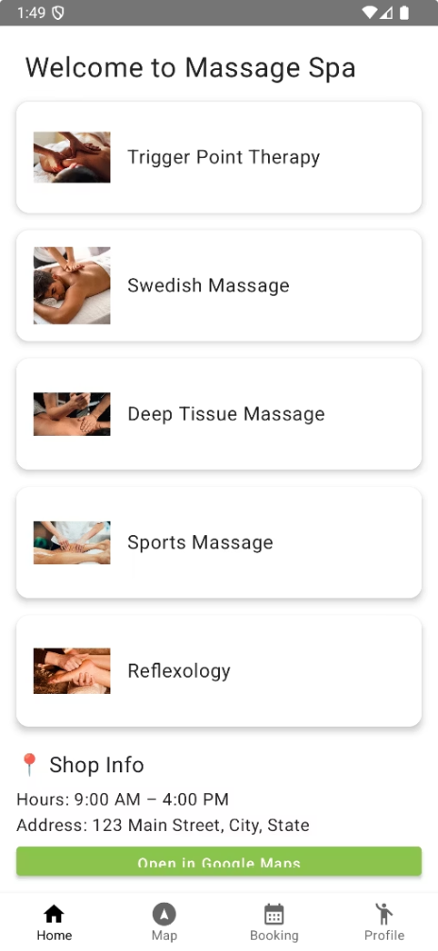

MassageApp: Streamlining Massage Therapy Bookings
MassageApp is a fully functional Android mobile application developed using Kotlin and Jetpack Compose, designed to streamline operations for massage therapy businesses. This application enables customers to conveniently book appointments, manage personal information, and accumulate loyalty points, while allowing business administrators to oversee bookings in real time.
The app features a user-friendly interface where customers can choose a massage service, select available time slots, enter personal details, and complete a simulated payment. Upon booking, customers automatically earn points (+10), which can be redeemed for rewards. If a booking is canceled, 10 points are deducted.

Slide 2








Technical Architecture
UI Layer
Composable screens for user interaction
Service Layer
Firebase integration services
Model Layer
Data classes for appointments
Navigation Layer
User flow and route transitions
On the backend, the app uses Firebase Authentication for user identity management and Firestore for real-time data storage and synchronization. All bookings are associated with the authenticated user's UID, ensuring each customer only views their personal data. The application integrates Google Maps for location services and ensures data persistence through Firebase, making it scalable, real-time, and suitable for commercial deployment.

Slide 3
Team Collaboration
Jonathan Guan
Hui Zhang
Core UI components using Jetpack Compose
AdminScreen with real-time synchronization
Navigation architecture and role-based access
Firebase Authentication implementation
BookingScreen, LoginScreen, and MainScreen
FirestoreService for data management
Firestore integration for bookings
Testing and debugging user flows
Points system and payment collection
Booking logic and history display
This project was collaboratively developed with balanced contributions across various aspects of the app. Both team members conducted regular code reviews, tested each other's modules, and collaborated using GitHub and Android Studio. Tasks were often discussed and then split based on feature or screen responsibility to streamline productivity.

Slide 4

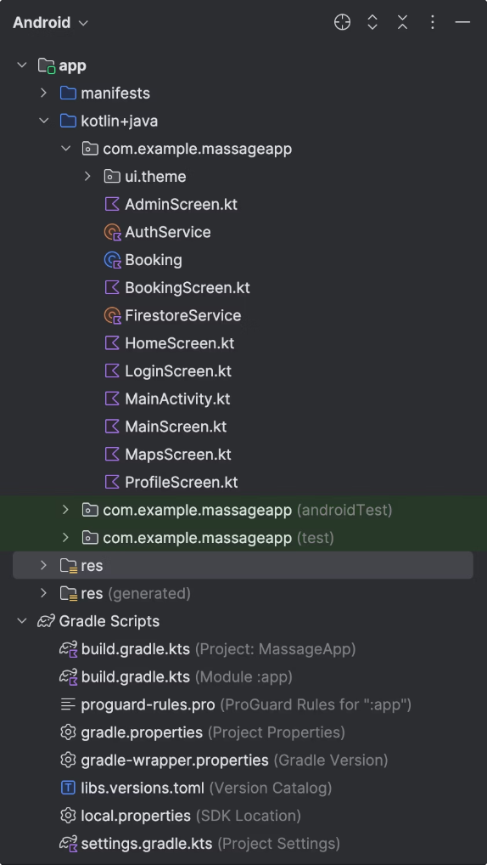




Navigation Flow
Authentication
Users login or register, with role detection for admin vs regular users
Main Navigation
Bottom navigation toggles between Home, Map, Booking, and Profile screens
Booking Process
Service selection, time slot booking, payment simulation, and confirmation
Profile Management
View loyalty points, booking history, and personal information
The app implements a clean navigation structure using androidx.navigation.compose.NavHost. Within MainScreen.kt, Bottom Navigation toggles between key sections while maintaining route-based transitions. Admin users receive a specialized interface for managing all bookings across the system.

Slide 5

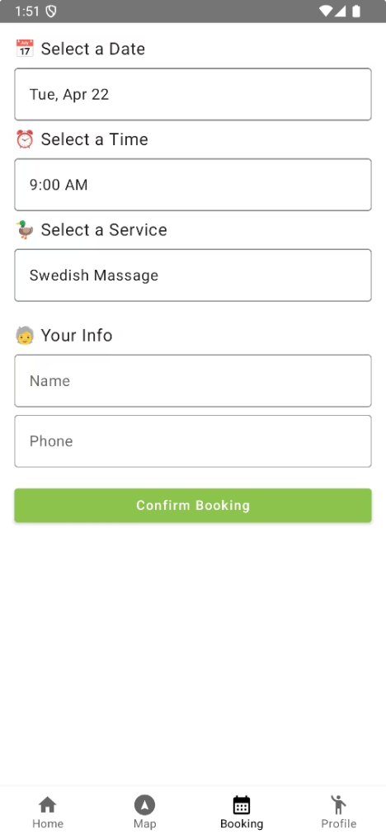




Key Technical Features
Double Booking Prevention
Before saving a new appointment, the app queries Firestore to check if any booking already exists for the selected date and time, rejecting duplicate requests to ensure scheduling integrity.
Loyalty Point System
After register automatically gives 20 point. Users earn +10 points for each booking and lose 10 points for cancellations, creating a lightweight yet effective retention mechanism ready for future expansion into rewards.
Simulated Payment Flow
A modal dialog prompts users for mock payment details, storing them securely in Firestore, with architecture ready for integration with real payment providers.
Real-time Synchronization
All bookings update in real-time using Firestore's addSnapshotListener, ensuring both users and admins always see the current state of appointments.

Slide 6
Demo Time

Slide 7
Code Structure

Slide 8








Reusable Components
AuthService.kt
FirestoreService.kt
Centralized wrapper for Firebase Authentication that can be reused in any app requiring user login and role verification
Backbone for all Firestore operations, adaptable for various reservation-based applications
Booking Model
UI Patterns
Data class and time generators designed for any scheduling application
Custom dropdowns and dialog components built for reuse across different Compose projects
The app was intentionally built using modular, decoupled components that can be easily reused in other Android applications. Each service encapsulates specific functionality, from authentication to data persistence, making them portable across projects. The UI components follow consistent patterns that can be adapted for various booking or reservation systems.

Slide 9
Admin Control Panel
Comprehensive Booking View
Cancellation Management
Admins can see all bookings across all users in a single interface, with real-time updates as new appointments are created.
One-tap cancellation of any appointment, with automatic point deduction and immediate removal from the database.
Role-Based Access
Business Intelligence
Admin privileges are granted by checking for the email admin@spa.com, providing a simple but effective authorization mechanism.
The admin view provides insights into booking patterns and customer preferences to inform business decisions.
The AdminScreen.kt provides a centralized control panel where business administrators can oversee all bookings in real time. This specialized interface is only accessible to authenticated admin users and provides powerful tools for managing the massage therapy business operations.

Slide 10



Lessons Learned & Future Improvements
Jetpack Compose Advantages
Faster UI development with declarative paradigm
Firebase Benefits
Real-time sync simplifies state management
Architecture Importance
Centralized services improve scalability
For future improvements, the team would implement ViewModels with StateFlow for better state management, introduce Hilt for dependency injection, separate the navigation graph into modular files, and integrate real payment APIs for a production-ready solution.
The course provided a strong foundation, but deeper instruction on advanced navigation, Firebase relationships, state management, and testing would have been beneficial. Adding project code reviews and real-world payment integration examples could further enhance the learning experience for future developers.

Slide 11
THANK YOU!

